Slide 1
Smart Food Diary With Calorie And Nutrient Breakdown
Batch 15
Track Your Calories and Nutrients Effortlessly.
Your Personalized Guide to Health and Wellness!

Slide 2
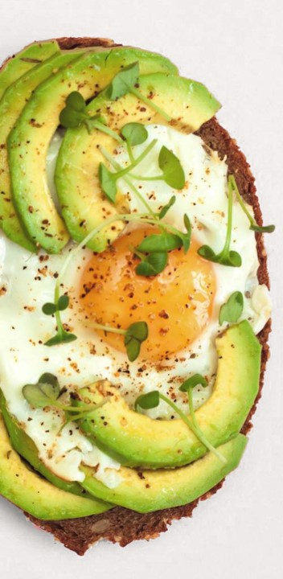
Milestones
Milestone 1
User Authentication and Image Logging
class diagram
Nutritional Analysis
Report and Export
Admin Dashboard
tip
login
Nutrition analysis
report

Slide 3
Table of Contents
Class Diagram…………………………..…04
Introduction…………………………………05
Home Page………………………………….06
Registration Page…………………………08
Login Page…………………………………..09
Google Verification……………………….10
Dashboard…………………………………..11
Upload Image………………………………13
Report Generation……………………….15
Visualisation……………………………….16
Conclusion…………………………….......20

Slide 4
Nutrition
- analysisId: int
- calories: float
- proteins: float
- carbs: float
- fats: float
+ calculateTotalNutrients(): Map<string, float>
+ validateNutrients(): boolean
Class Diagram
Admin
- adminId: int
+ getUsersList(): List<User>
+ getSystemStats(): Map<string, any>
+ getConfigurations(): List<SystemConfig>
1
1
User
- userId: int
- username: string
- email: string
- password: string
- isAdmin: Boolean
+ register(): boolean
+ login(): AuthToken
+ logout(): boolean
+ resetPassword(): boolean
*
Meal
- logId: int
- userId: int
- timestamp: DateTime
- imageUrl: string
+ addMeal(): MealLog
+ updateMeal(): boolean
+ analyzeMeal(): NutritionData
Report
- reportId: int
- type: string
- dateRange: DateRange
+ generateReport(): PDF
+ exportData(): CSV
+ getVisualizations(): List<Chart>
1
*
*
1
1
1
Dashboard
- userId: int
+ getMealHistory(): List<MealLog>
+ getNutritionSummary(): NutritionSummary
+ getReports(): List<Report>
1
Data Visualization
- chartId: int
- type: string
+ createChart(): Chart
+ updateData(): boolean
+ exportChart(): Image
*

Slide 5

Introdution:
The Smart Food Diary with Calorie and Nutrient Breakdown is an innovative, AI-driven solution designed to revolutionize how users track and manage their dietary habits.
By leveraging advanced image recognition technology, the application automatically detects food items from uploaded images and analyzes their nutritional content, offering a seamless meal logging experience.
This intuitive and user-friendly tool empowers users to make informed dietary choices through detailed calorie and nutrient breakdowns, personalized recommendations, and interactive visualizations of their nutritional trends.
With robust features like customizable reports and real-time dietary alerts, the Smart Food Diary not only enhances individual health management but also provides valuable insights for achieving long-term wellness goals.

Slide 6
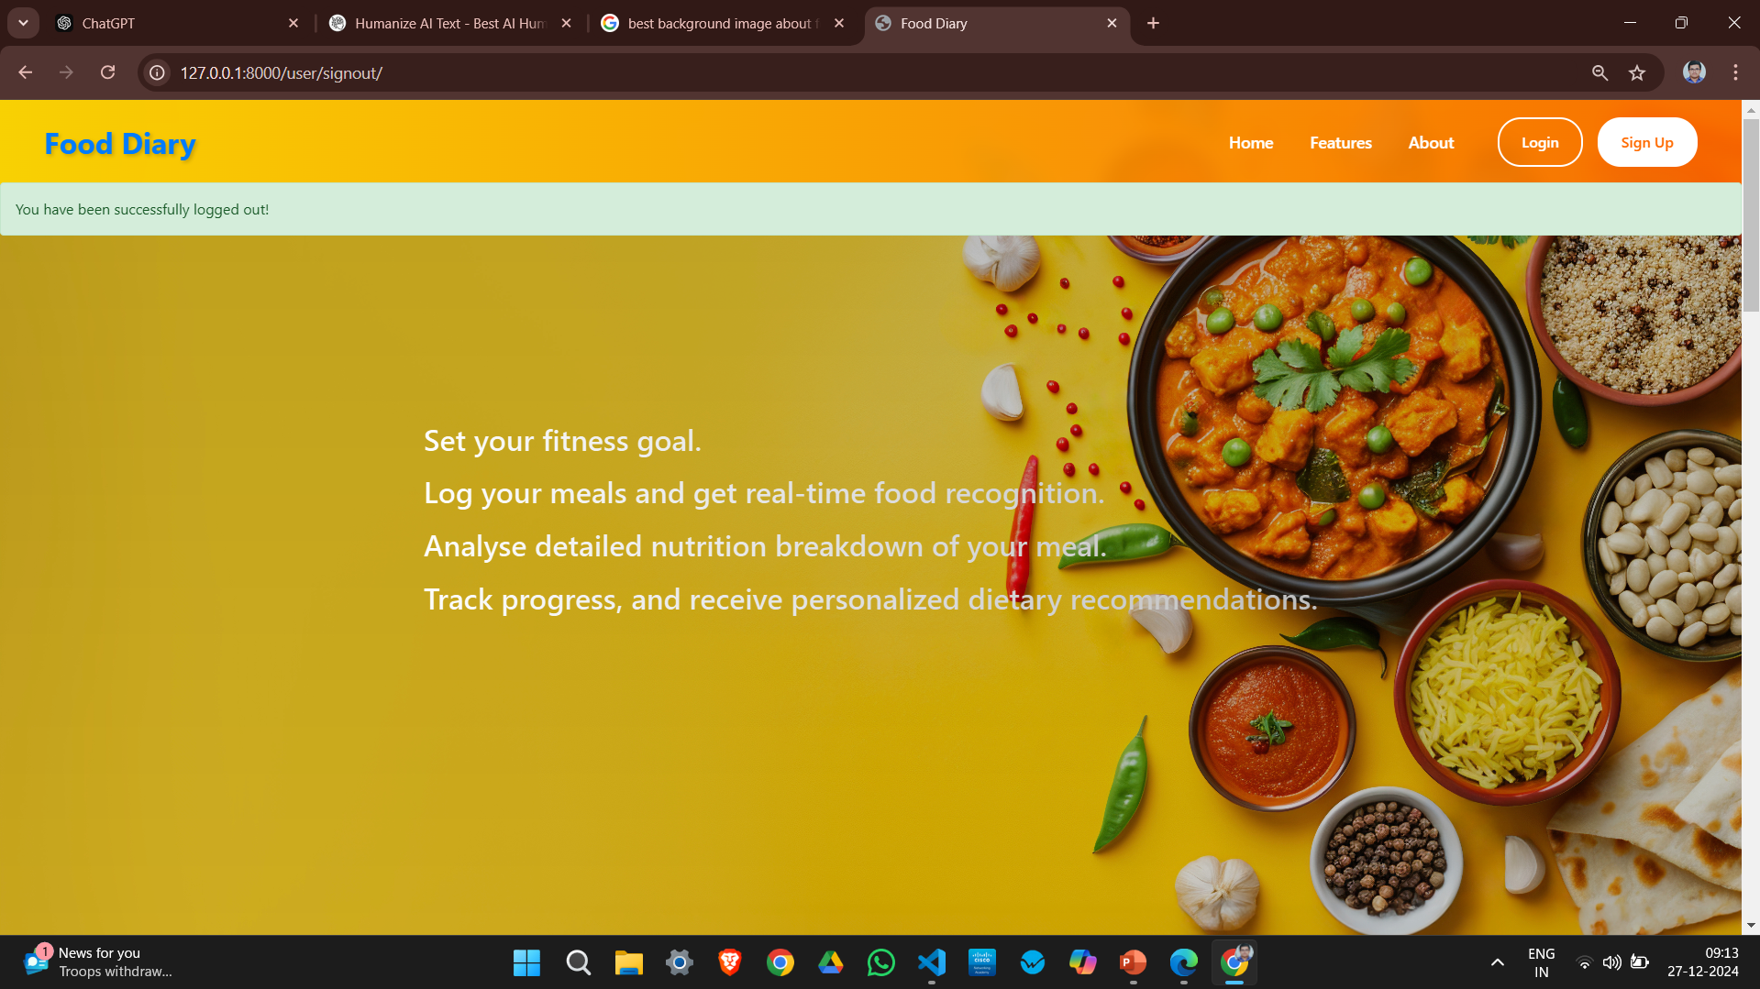
"Track your calories and nutrients effortlessly," clearly conveys the platform's functionality.
Home Page
Tip
As a user can able to register, login or read buttons are available in this page
A fresh and vibrant background featuring fruits and greens gives a healthy and appealing vibe.
"Track your calories and nutrients effortlessly," clearly conveys the platform's functionality.
Contact Information
The homepage effectively sets a positive tone with its fresh visuals and clear message. Refining alignment and organization would enhance professionalism further.

Slide 7
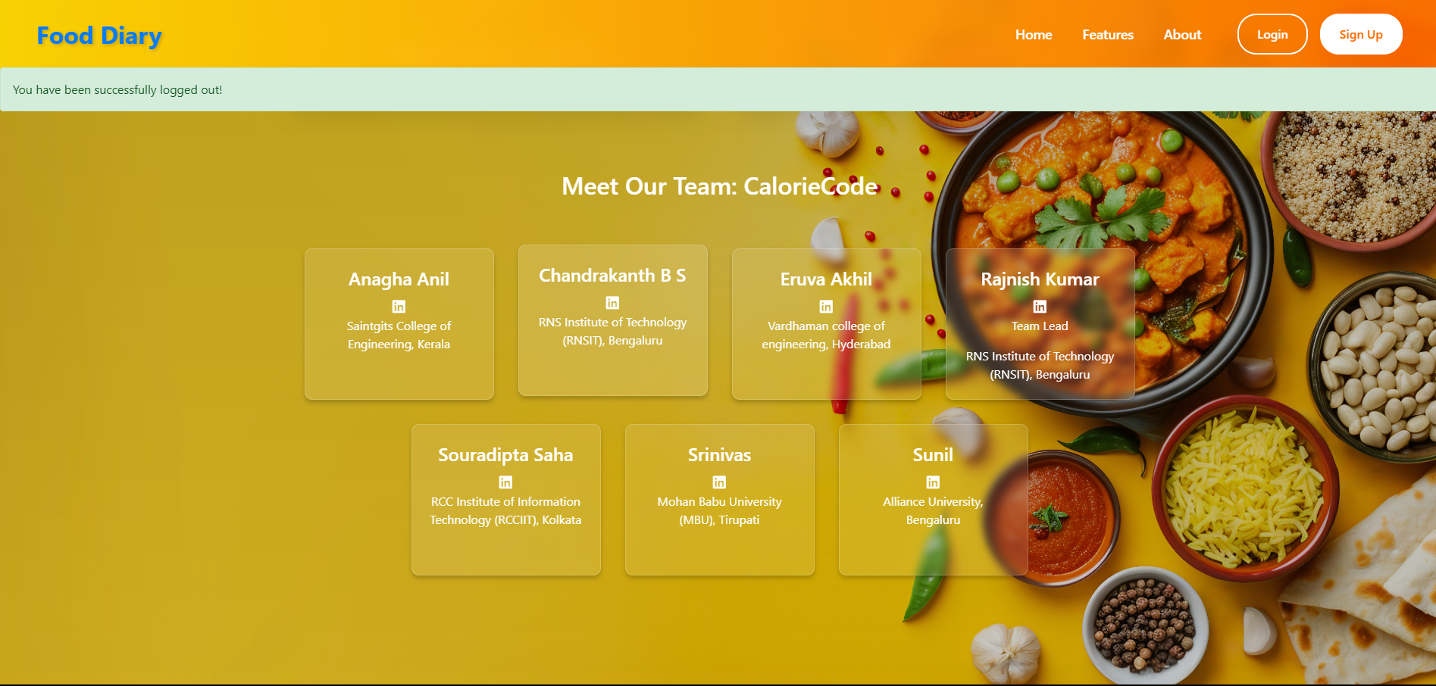
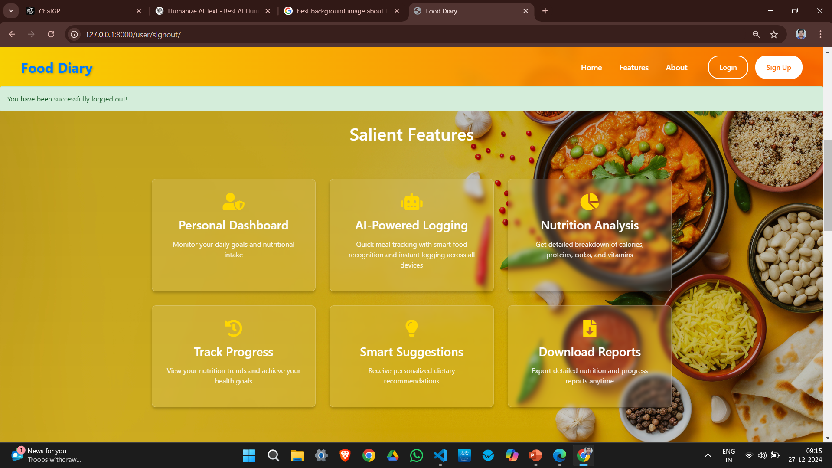
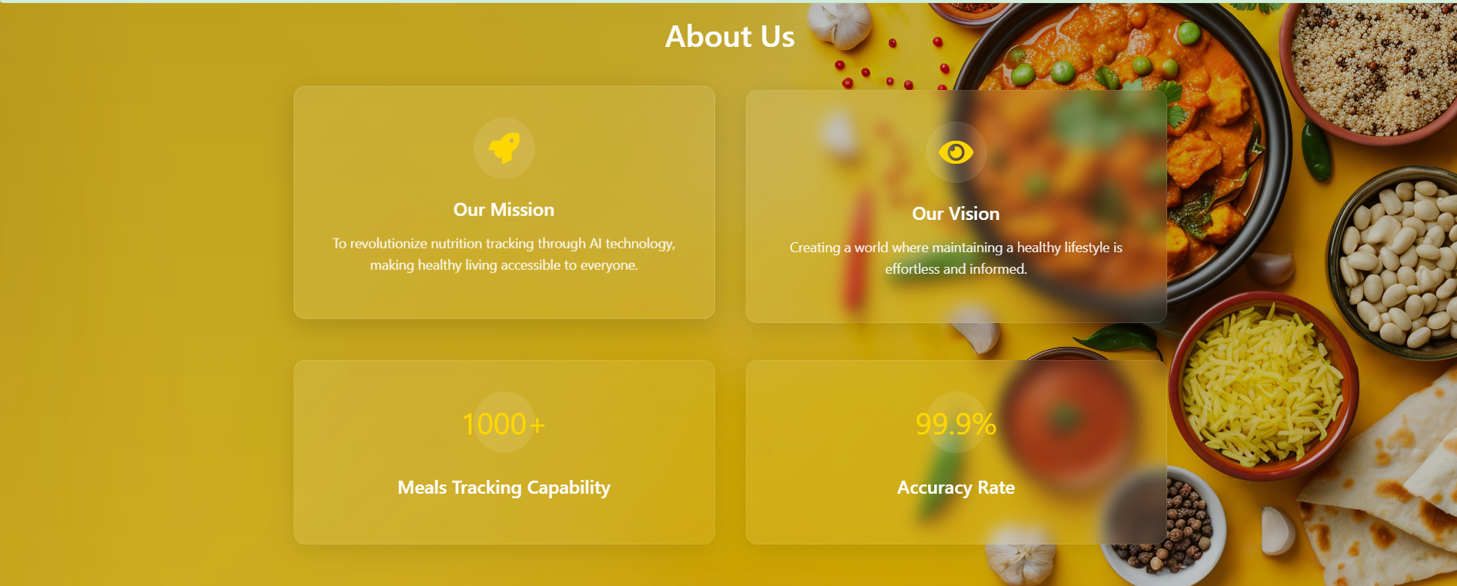

Slide 8

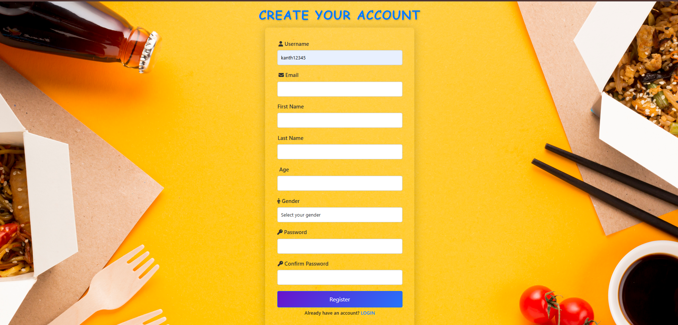
"Track your calories and nutrients effortlessly," clearly conveys the platform's functionality.
Registration page
Tip
As a new you can register hereby there detail information and password
2
A clean and simple form layout is centered, with a bright yellow-orange background that gives the page a warm, inviting feel.
The form collects essential details for account creation, including:Username,Email,Name,Age,Gende,password (with detailed requirements listed below the field),Password Confirmation

Slide 9
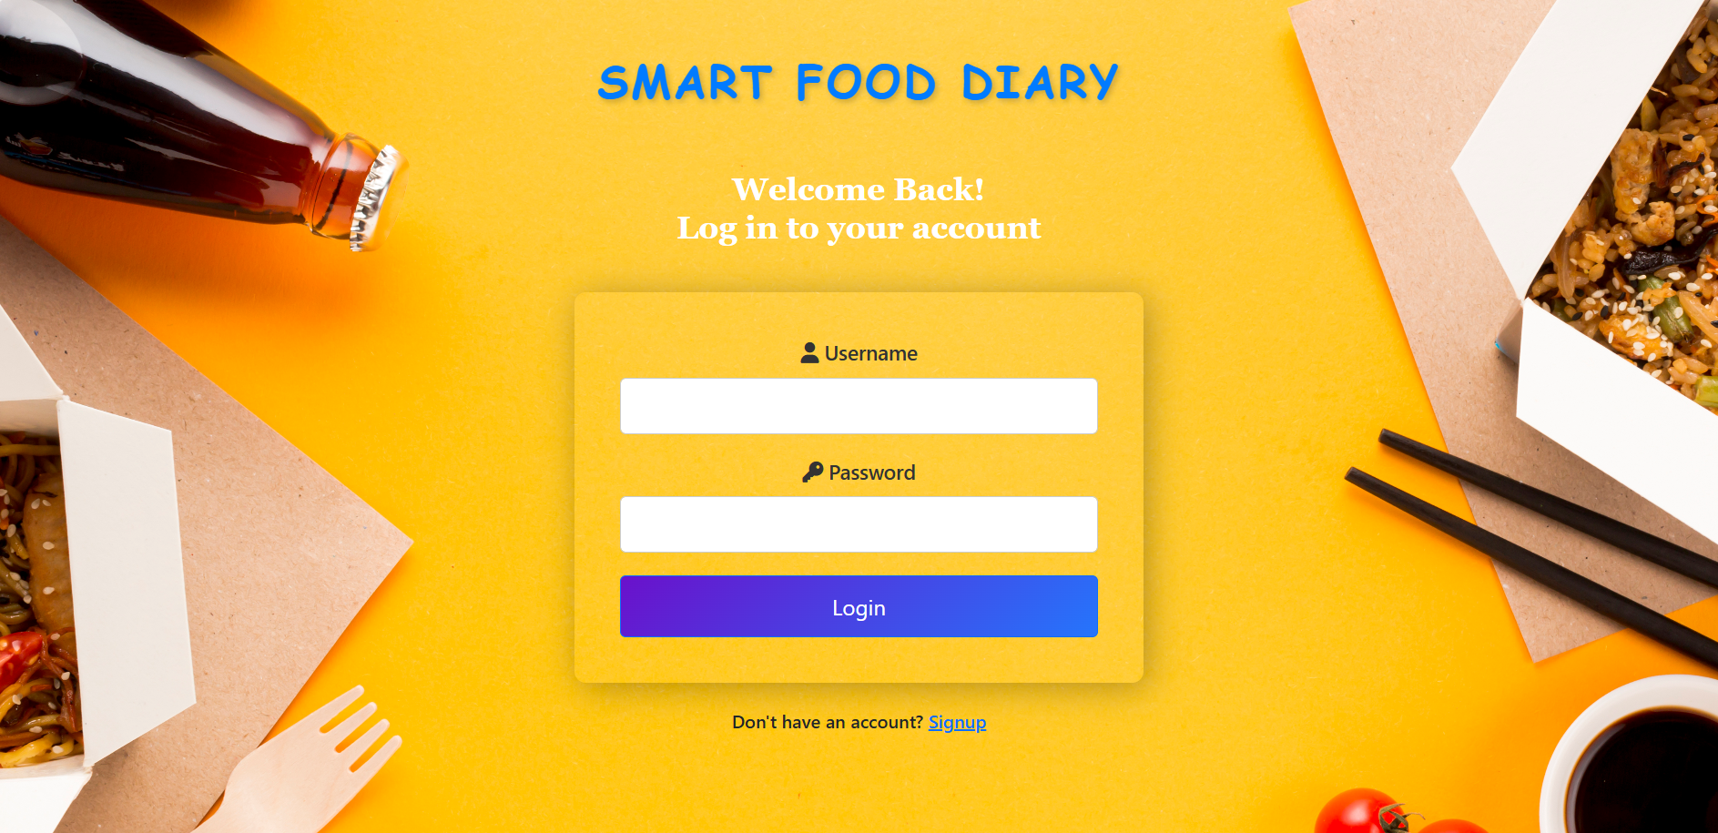
"Track your calories and nutrients effortlessly," clearly conveys the platform's functionality.
Login page
Tip
Here you can login after account creation and email verification
A clean and simple form layout is centered, with a bright yellow-orange background that gives the page a warm, inviting feel.
The form collects essential details for account login: Username and Password

Slide 10
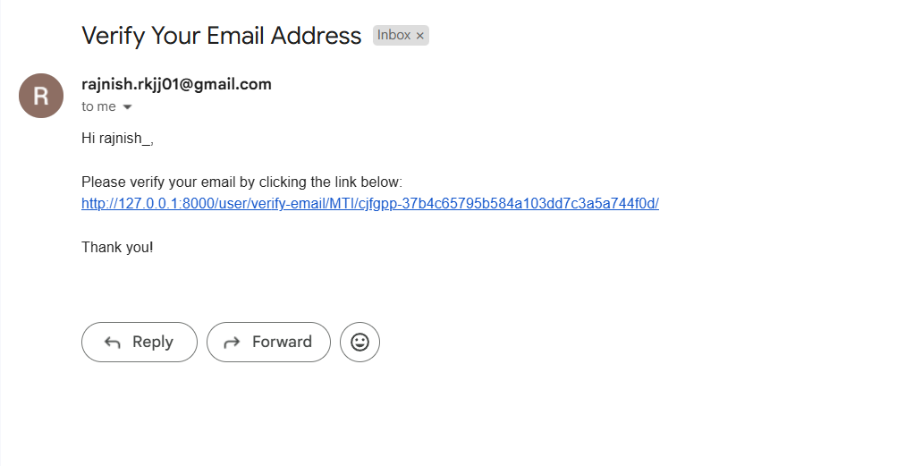
"Track your calories and nutrients effortlessly," clearly conveys the platform's functionality.
Google Verification
Tip
Here you need to confirm that your email ID is being used for account creation.
Provides a secure way to verify user email addresses, ensuring only valid users gain access to the application.
Enhances user account authenticity and reduces the risk of spam or fake registrations.

Slide 11
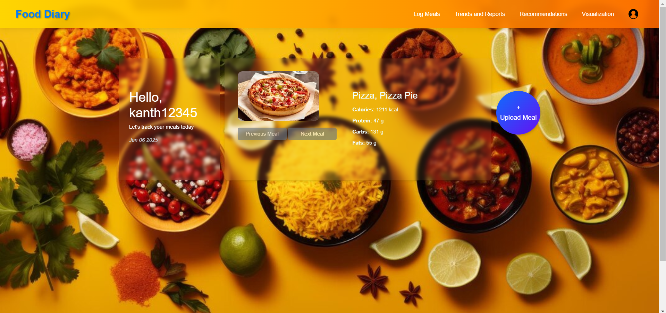
"Track your calories and nutrients effortlessly," clearly conveys the platform's functionality.
Dashboard
Tip
Dashboard can be able to upload the image to detect the food items and set the goals of calorie
A clean and simple form layout is centered, with a bright yellow-orange background that gives the page a warm, inviting feel.
Dashboard provides option for image upload, nutritional breakdown of food, visualization charts and exportable report.

Slide 12
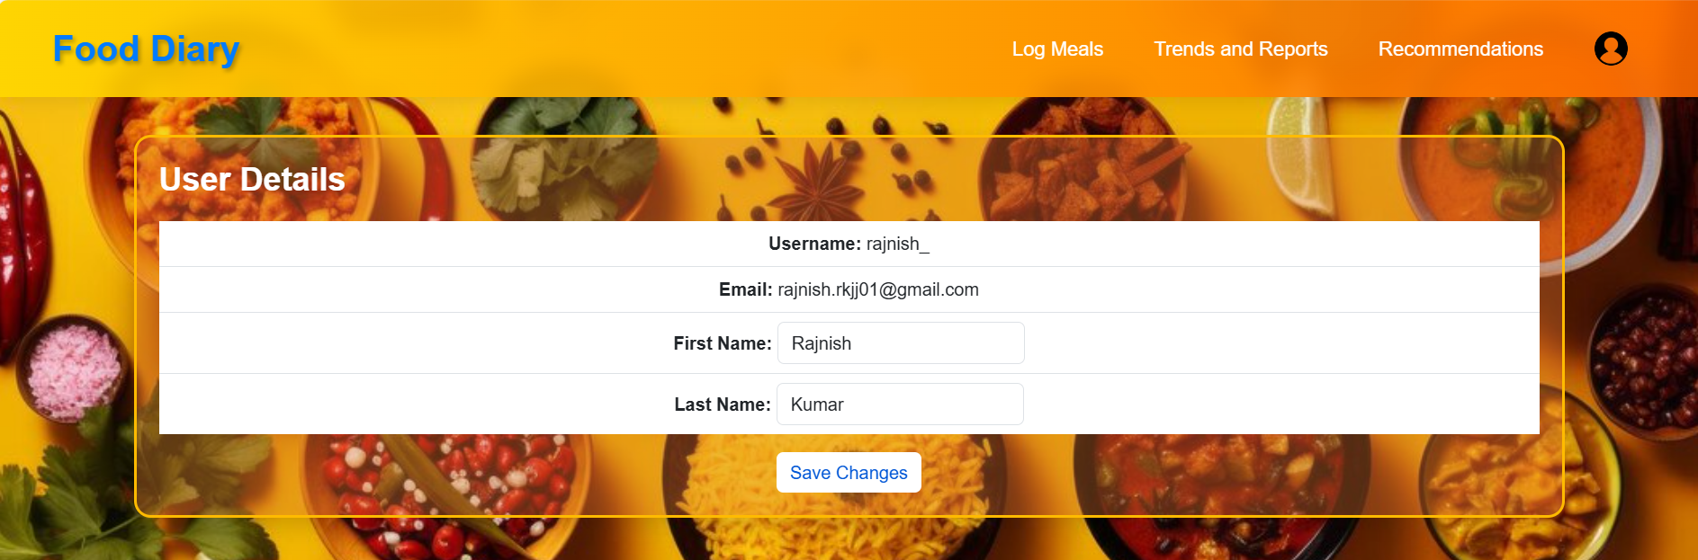
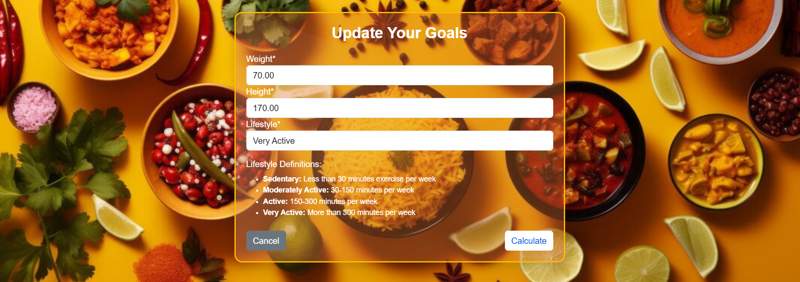

Slide 13
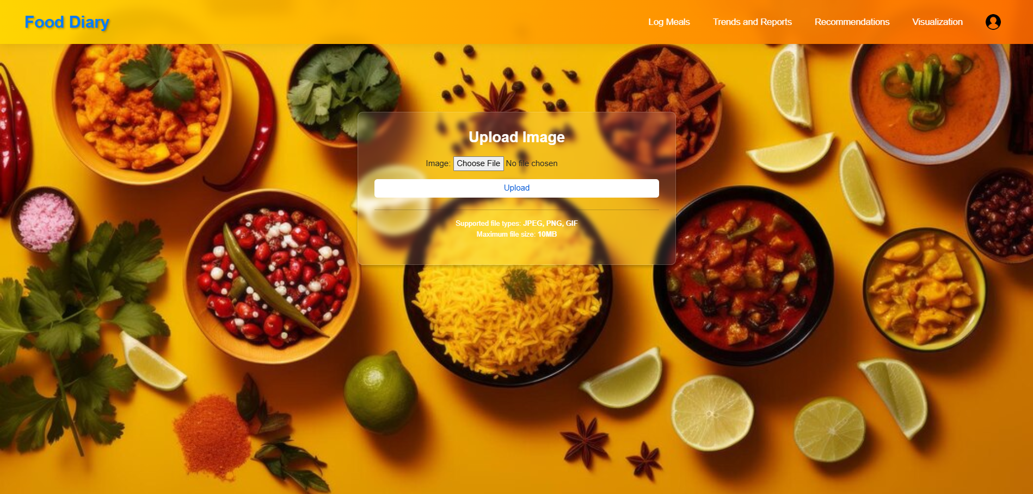
"Track your calories and nutrients effortlessly," clearly conveys the platform's functionality.
Upload Image
Tip
Upload page is used to upload the image of food from computer directory
Simplifies meal logging by allowing users to upload images of their meals for automated recognition and analysis.
Enhances user engagement with an intuitive and visually appealing interface, making the application user-friendly.

Slide 14
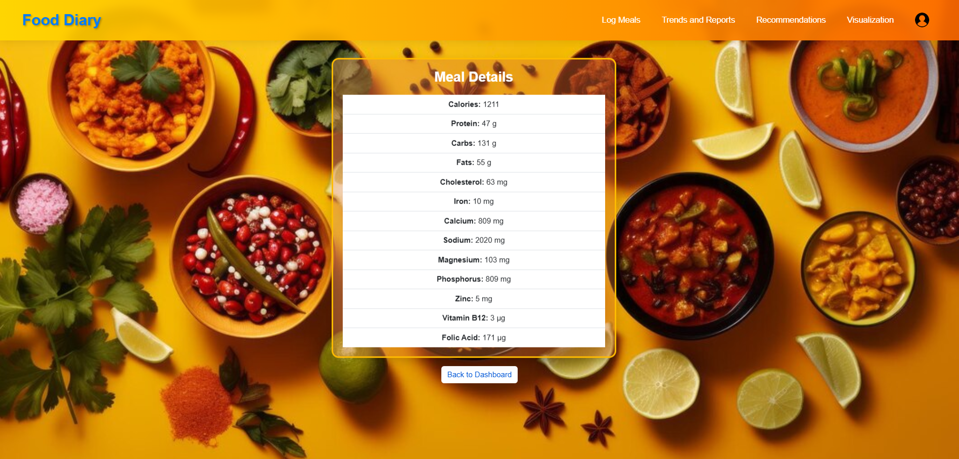

Slide 15
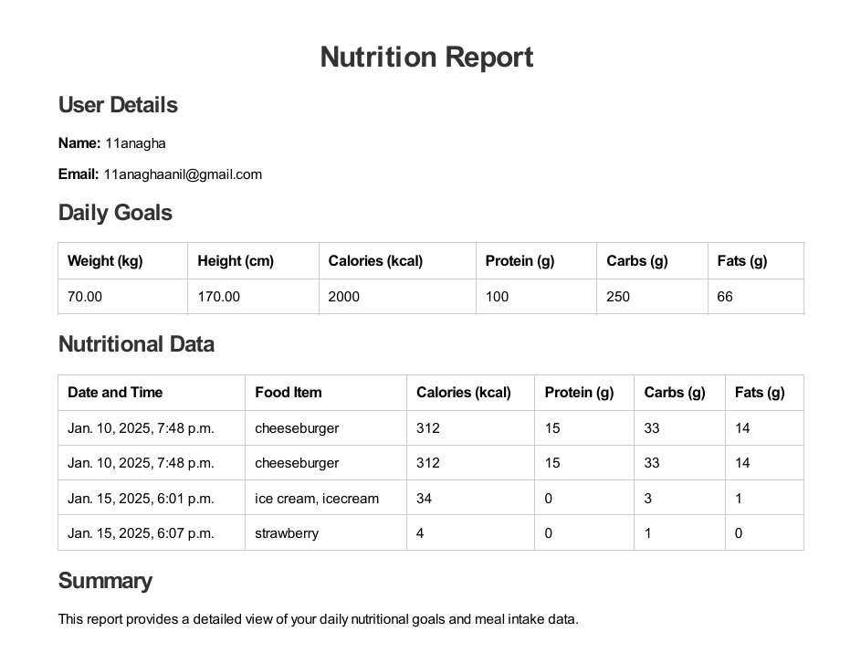
"Track your calories and nutrients effortlessly," clearly conveys the platform's functionality.
Report Generation
Tip
Trends and Report is used to generate pdf report of the meals consumed.
Provides a detailed summary of individual nutritional intake based on daily goals, helping users stay on track with their dietary plans.
Displays a breakdown of calories, proteins, carbs, and fats for each food item, enabling users to make informed choices.
Allows tracking of meal timings to identify eating patterns and improve meal planning.

Slide 16
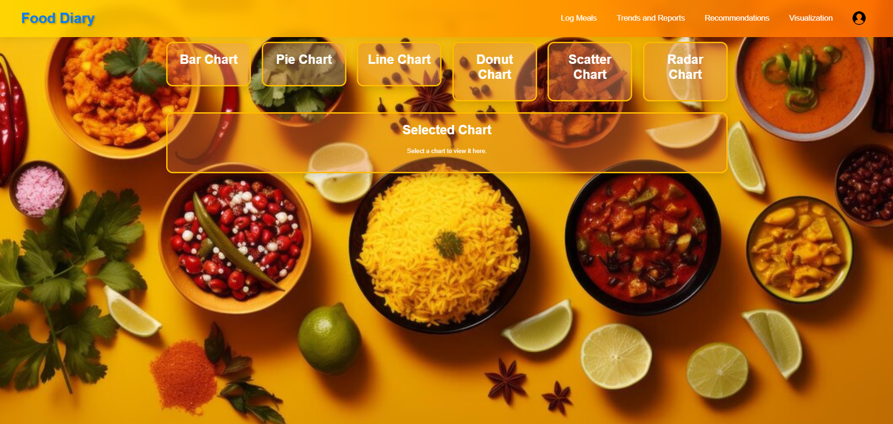
Visualization

Slide 17
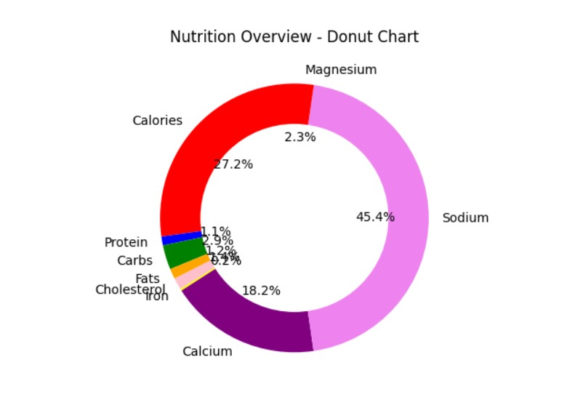
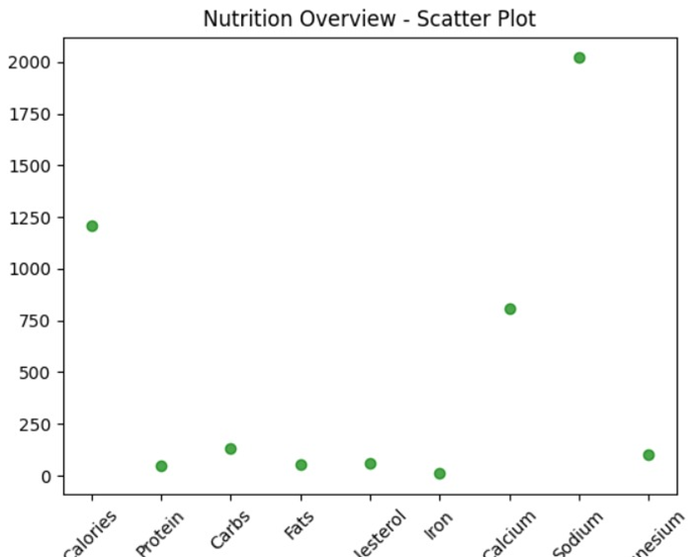

Slide 18
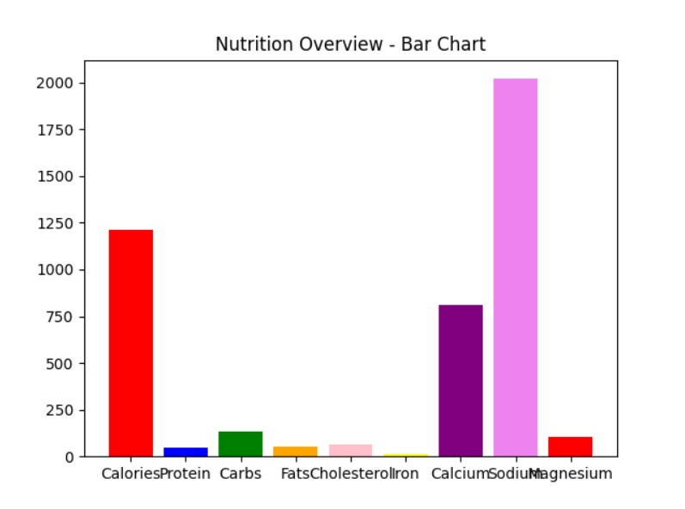
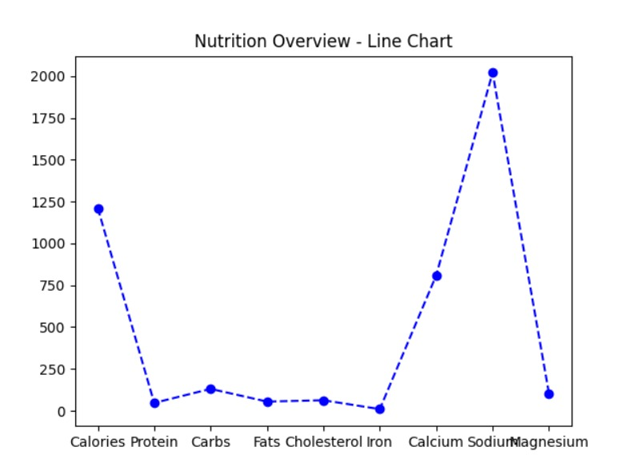

Slide 19
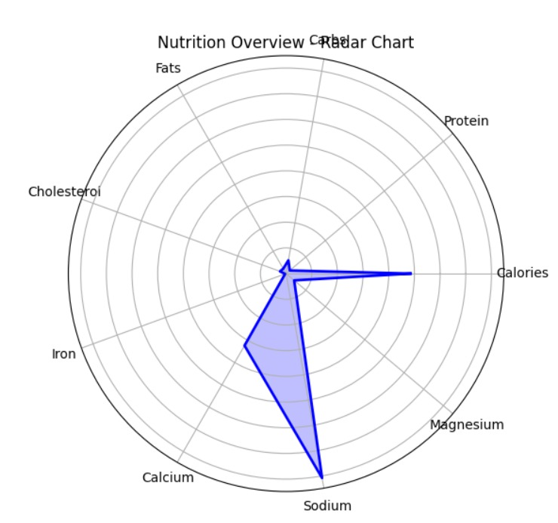
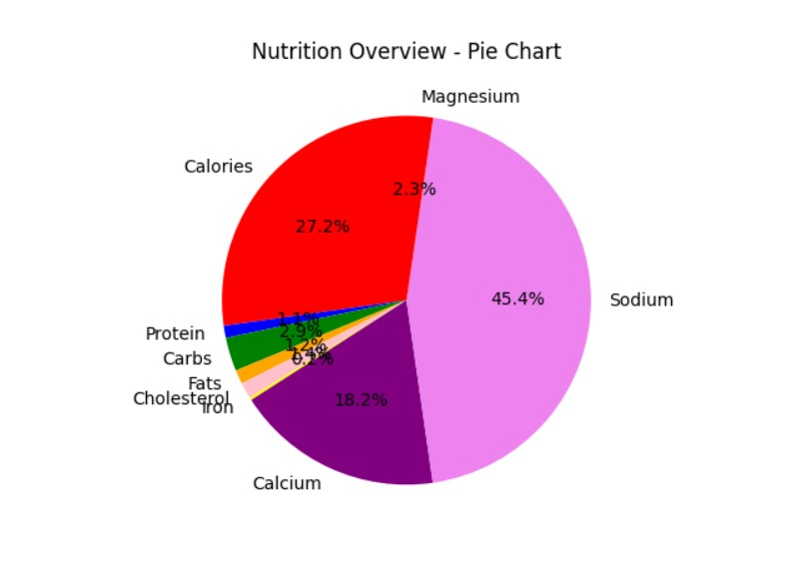

Slide 20
CONCLUSION
The Smart Food Diary with Calorie and Nutrient Breakdowns project was meant to provide a complete and user-centric solution for tracking and assessing eating habits alongside nutrient intakes for better lifestyles. Using state-of-the-art technologies like image recognition, machine learning, and interactive data visualization, this application simplifies meal logging and generates actionable insights tailored to customized goals. With features like personalized dietary recommendations, customizable reports, and trend analyses, there is no doubt that this project allows users to efficiently monitor and optimize their nutrition. This further shows how technology can encourage wellness and empower people to make informed, sustainable decisions about their diets.

Slide 21
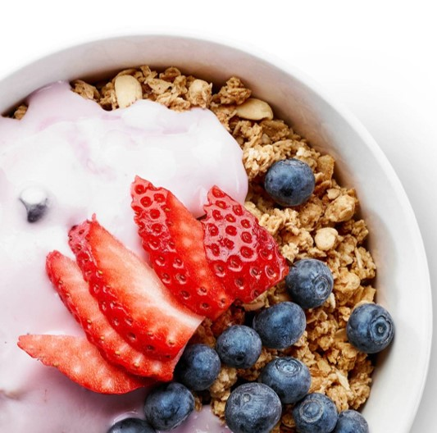
Team members
Rajnish Kumar
Anagha Anil
Eruva Akhil
Chandrakanth B S
Souradipta Saha
Sunil

Slide 22


